Slide 1


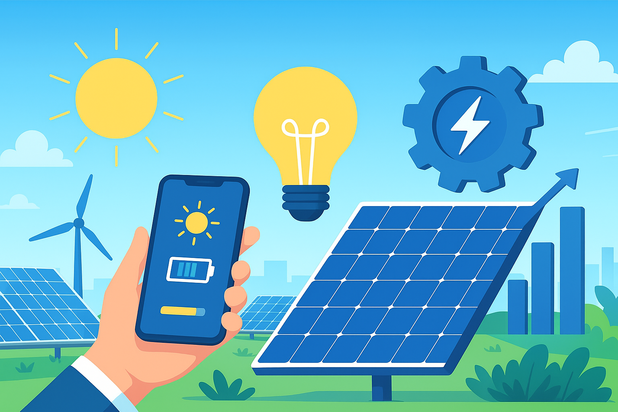


EEC1361 – SOLAR ENERGY TECHNOLOGY
Hybrid Powered Dual-Brush Dry Cleaning System for Enhancing Solar Photovoltaic Panel Efficiency
BATCH NO:19
PRESENTED BY:
1. BHARANIDHARAN T[927623BEE013]
2.KISHWAR R[927623BEE045]
3.MYMUKIL K[927623BEE058]
4.NANDHISH P[927623BEE059]
GUIDED BY:
Mr.M.RAMESH
Assistant Professor/EEE
MODEL REVIEW PRESENTATION
05-12-2025

Slide 2
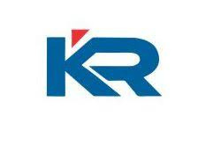
ABSTRACT
This project presents a low-cost, waterless solar panel cleaning robot that uses a dual-brush system consisting of a nylon brush and a microfiber roller.
The robot moves over solar panels, removing dust and fine particles without the need for air compressors or water.
A rechargeable battery with solar charging powers the cleaning and mobility of the system, making the design energy-efficient and easy to deploy.
The prototype offers a lightweight, modular, and maintenance-friendly solution for improving solar panel efficiency in residential and small solar farm installations.
MODEL REVIEW PRESENTATION
05-12-2025

Slide 3
OBJECTIVE
To design a lightweight, low-cost solar panel cleaning robot that operates without water or air compressors.
To achieve effective dust removal using a dual-brush system with nylon and microfiber rollers.
To enable movement across solar panels using a simple motor-driven mobility mechanism.
To ensure continuous and reliable operation through a rechargeable battery with optional solar trickle charging support.
MODEL REVIEW PRESENTATION
05-12-2025

Slide 4
INTRODUCTION
Solar panels lose efficiency when dust and dirt accumulate on their surface, making regular cleaning essential for maintaining optimal power output.
Manual cleaning is time-consuming, labour-intensive, and often difficult on large or hard-to-reach rooftop installations.
To address this a waterless cleaning robot using nylon and microfiber brushes offers an efficient and low-maintenance solution.
This prototype provides a simple, affordable approach to keeping solar panels clean while reducing human effort and improving long-term energy generation.
MODEL REVIEW PRESENTATION
05-12-2025

Slide 5
LITERATURE REVIEW
Title: "Autonomous Dry Cleaning System for Solar PV Panels"
Source: IEEE Xplore
Summary: Presents a waterless robotic cleaning mechanism using rotating brushes for dust removal on solar panels. Demonstrates that dry cleaning methods significantly improve panel efficiency while reducing maintenance costs and water usage in arid regions.
Title: "Brush-Based Robotic Mechanism for Maintaining Rooftop Solar Installations"
Source: IJEETR (International Journal of Electrical Engineering & Technology Research)
Summary: Discusses a lightweight mobile robot using nylon bristles for safe surface cleaning. Highlights the effectiveness of soft-bristle brushes in preventing micro-scratches while maintaining consistent cleaning performance on rooftop solar arrays.
MODEL REVIEW PRESENTATION
05-12-2025

Slide 6
EXISTING METHOD
Brush-based systems often struggle with uneven or accumulated dust layers:
Existing nylon brush cleaners are not always effective when dust is thick, sticky, or unevenly deposited, leading to incomplete cleaning in a single pass.
Air blower/air-jet systems are expensive and energy-intensive:
High-pressure air cleaning requires powerful motors or compressors, increasing cost, weight, and power consumption, making them unsuitable for small installations.
Electrostatic cleaning is not effective for sticky or heavy dust:
It only removes loose particles and fails against mud, bird droppings, pollen, or moisture-bound dust.
Manual waterless tools are labor-dependent and slow:
Manual brushes or microfiber cleaners require human effort, making them impractical for large installations or daily cleaning needs.
MODEL REVIEW PRESENTATION
05-12-2025

Slide 7
PROPOSED METHOD/PROJECT
The robot uses a dual-brush system with a nylon brush and a microfiber roller to clean solar panels effectively without water or air.
A lightweight frame with DC gear motors allows the robot to move along the panels.
A rechargeable battery with optional solar trickle charging powers the cleaning and mobility system for continuous operation.
Dust collected by the brushes is captured in a removable tray, ensuring clean surfaces and easy maintenance.
MODEL REVIEW PRESENTATION
05-12-2025

Slide 8
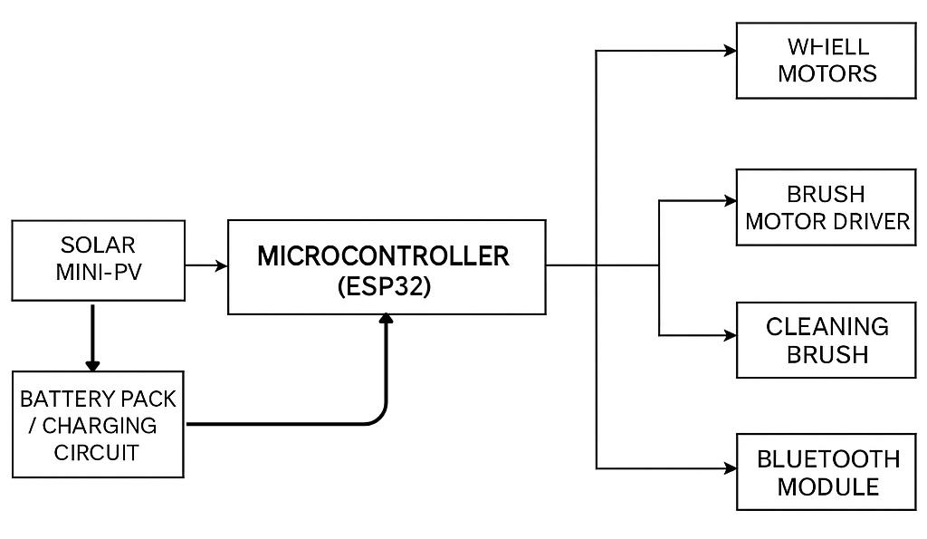
BLOCK DIAGRAM

Slide 9
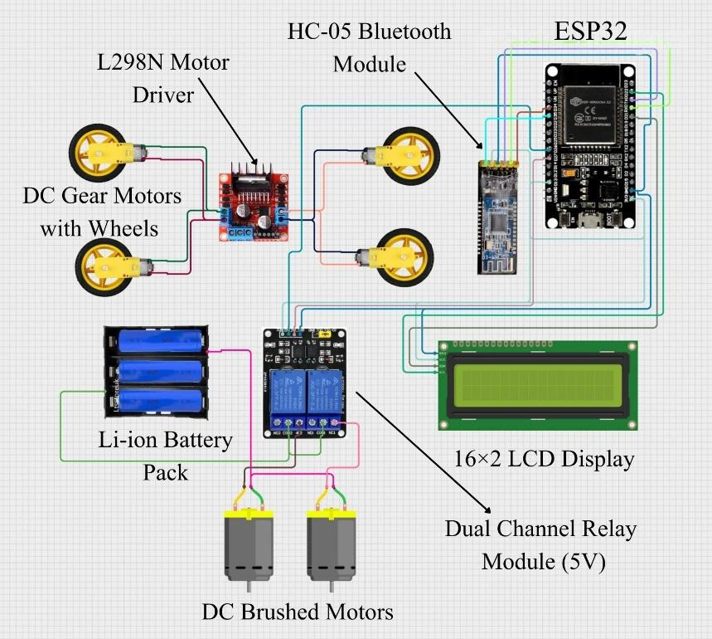
CIRCUIT DIAGRAM

Slide 10
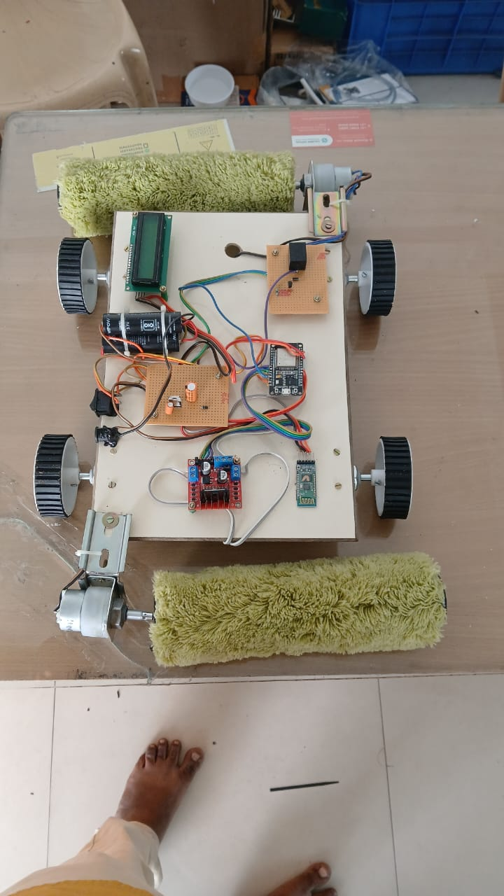
PROTOTYPE

Slide 11
COMPONENTS DETAILS
1. Microcontroller & Modules
ESP32 Board
HC-05 Bluetooth Module
2. Motor Control Components
L298N Motor Driver Module
DC Gear Motor
3. Display Unit
16×2 LCD Display Module
MODEL REVIEW PRESENTATION
05-12-2025

Slide 12
WORKING
The ESP32 receives control signals through the HC-05 Bluetooth module, allowing the user to operate the robot wirelessly.
Based on these commands, the ESP32 sends control signals to the L298N motor driver to move the robot forward, backward, left, or right.
The DC motors connected to the wheels rotate accordingly, enabling the robot to navigate across the surface.
The custom circuit boards handle power distribution, relay control, and signal conditioning to ensure stable operation.
The LCD display shows essential information such as status, commands received, or battery-related messages during operation.
MODEL REVIEW PRESENTATION
05-12-2025

Slide 13
RESULT AND DISCUSSION
The robot successfully received and executed Bluetooth commands, showing smooth wireless control through the HC-05 module without delays or communication drops.
Movement of the robot was stable and consistent, as the L298N motor driver and DC motors provided adequate torque and directional control on the test surface.
The ESP32 processed commands accurately, demonstrating reliable integration between the controller, motor driver, relay board, and power circuitry.
The LCD display functioned effectively, providing real-time status updates such as connection confirmation, command response, and system readiness.
Overall system performance was efficient, with the prototype showing good responsiveness, stable power handling through the capacitor bank, and smooth coordinated operation of all hardware modules.
MODEL REVIEW PRESENTATION
05-12-2025

